Slide 1
Enterprise Systems
Last Week we had completed talking about TPS – Transactional Processing Systems
We were about to start talking about the Network Operating Systems
and thin and thick clients
This week we will cover
Enterprise architecture frameworks
Enterprise architecture as a supply chain
Some more enterprise systems
Data centers

Slide 2
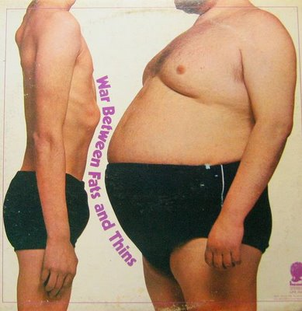
Thick vs. Thin client Net Operating Systems

Slide 3
2 Tier PAD (packet assembler/disassembler) Architecture
Presentation
Application
Data
Fat Client
Server
Notes:
Short for packet assembler/disassembler PAD is a device (hardware or software) used in packet switching to enable data terminal equipment (DTE) not equipped for packet switching to access a packet-switched network.

Slide 4
Start withPAD Model – 2 Tier
PAD (packet assembler/disassembler) Model – 3 Tier
Presentation
Application
Data
Server
Thin Client
Server
Server
Notes:
packet assembler/disassembler

Slide 5
PAD (packet assembler/disassembler) Model – n Tier
Presentation
Application
Data
Thin Client
Servers
Servers

Slide 6
Underlying Technologies
LANs
Usually a thin client
Access to the servers housing the Business Rules of the Transaction Processing System (TPS)
Always a large Database server
Older models this is a single DB
WANs
Client is similar
Business Rules (application) is distributed (there is often a middleware component as well)
DB is distributed

Slide 7
Readings from this last week (Did you read these?)
Because IT systems have become
unmanageably complex
increasingly costly to maintain
because they are mission critical…
Enterprise architecture methods help in reducing IT cost and complexity, while increasing business value and effectiveness

Slide 8
Enterprise Architecture Methods
There are 4 Enterprise Architecture Methods
The Zachman Framework
TOGAF (The Open Group Architectural Framework)
The Federal Enterprise Architecture
The Gartner/Meta Methodology
We will talk about two
So, what did you learn about the Zachman Framework ?
Please Explain
What about the Open Group Architectural Framework ?
Please Explain

Slide 9
Enterprise Architecture
The field of enterprise architecture essentially started in 1987, with the publication in the IBM Systems Journal of an article titled "A Framework for Information Systems Architecture," by J.A. Zachman
Enterprise Architecture sought to address
System complexity where organizations were spending more and more money building IT systems
Poor business alignment where organizations were finding it more and more difficult to keep increasingly expensive IT systems aligned with business need.

Slide 10
Zachman Framework
The Zachman framework is a logical structure intended to provide a comprehensive representation of an information technology enterprise.
Although self-described as a framework, is actually more accurately defined as a taxonomy
It deals with each meeting point between a player's perspective (for example, business owner) and a descriptive focus (for example, data.)
Zachman framework is an Ontology - A specification of conceptualization
In information technology, an ontology is the working model of entities and interactions in some particular domain of knowledge or practices, such as electronic commerce or "the activity of planning.“
Each player needs to know the what, how, where, who when and why but each focus is thought of differently by different players.

Slide 11
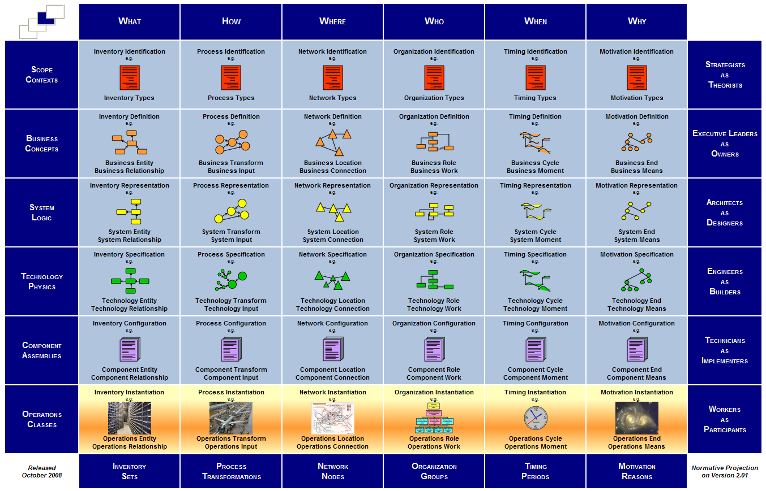
Zachman Framework
Notes:
As we move horizontally (for example, left to right) in the grid, we see different descriptions of the system—all from the same player's perspective.
As we move vertically in the grid (for example, top to bottom), we see a single focus, but change the player from whose perspective we are viewing that focus

Slide 12
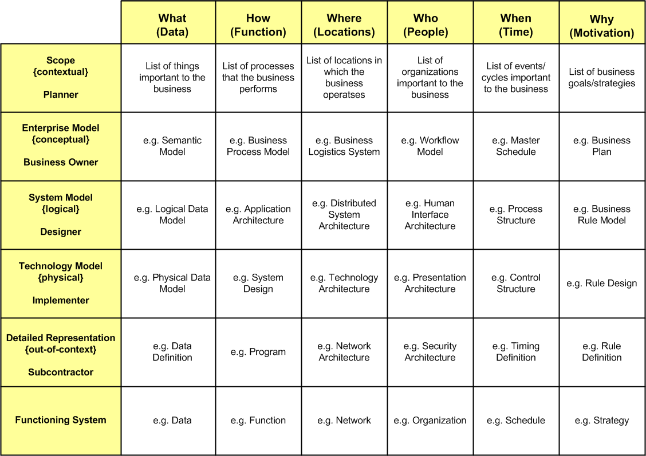
Zachman Framework
Notes:
Zachman Framework is an Ontology –A Sp

Slide 13
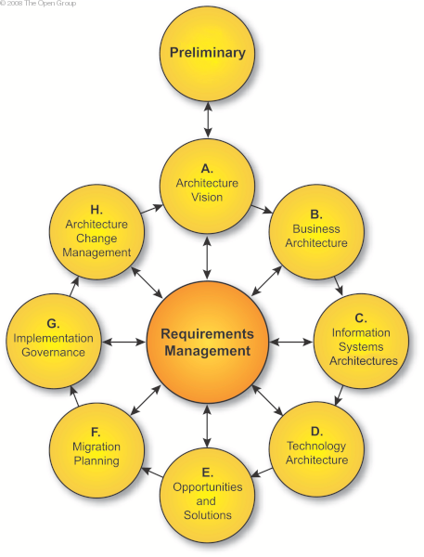
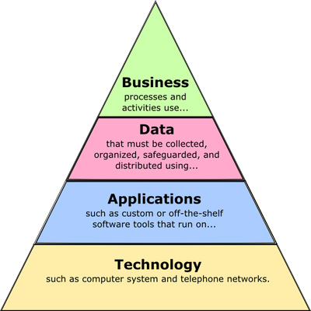
TOGAF The Open Group Architectural Framework
Although called a framework, is actually more accurately defined as a process.
TOGAF is an Architecture Development Method
Zachman tells you how to categorize your artifacts.
TOGAF complements Zachman and gives you a process for creating them.
Notes:
The Open Group Architectural Framework

Slide 14
Enterprise Architecture (as a supply chain)

Slide 15
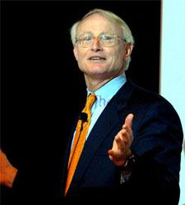
Michael Porter*put all this together in:
Porter’s Value Chain Model
(Understanding How Value is Created Within Organizations)
*Michael Porter a leading authority on competitive strategy and the competitiveness and economic development of nations, states, and regions. Professor at The Institute for Strategy and Competitiveness, based at the Harvard Business School. http://www.isc.hbs.edu/Pages/default.aspx
Notes:
Michael Porter is a leading authority on competitive strategy and the competitiveness and economic development of nations, states, and regions.

Slide 16
Profit
Firm Infrastructure
Technology and Product Development
Inbound
Logistics
Operations
Marketing
& Sales
Outbound
Logistics
Service
Procurement
Human Resources
Notes:
Inbound Logistics: the receiving and warehousing of raw materials, and their distribution to manufacturing. Refers to the transport, storage and delivery of goods coming into a business.
Outbound logistics refers to the transport, storage and delivery of goods going out of a business.

Slide 17
Profit
Firm Infrastructure
Technology and Product Development
Inbound
Logistics
Operations
Marketing
& Sales
Outbound
Logistics
Service
Procurement
Procurement
Supply Chain Management
Human Resources
Notes:
Supply Chain Management

Slide 18
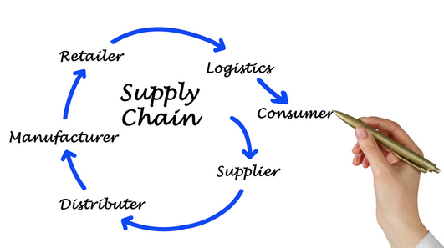
Supply Chain Model is the oversight of materials, information, and finances as they move in a process from supplier to manufacturer to wholesaler to retailer to consumer.

Slide 19

Supply chain management flows can be divided into three main flows:
The product flow
The information flow
The financial flow
The product flow includes the movement of goods from a supplier to a customer, as well as any customer returns or service needs.
The information flow involves transmitting orders and updating the status of delivery.
The financial flow consists of credit terms, payment schedules, and consignment and title ownership arrangements.
Supply Chain Systems track all three

Slide 20
Profit
Firm Infrastructure
Technology and Product Development
In the Supply Chain Model what is considered
CRM?
Inbound
Logistics
Operations
Outbound
Logistics
Marketing
& Sales
Service
Procurement
Procurement
Customer Relationship Management
Human Resources
Notes:
CRM

Slide 21
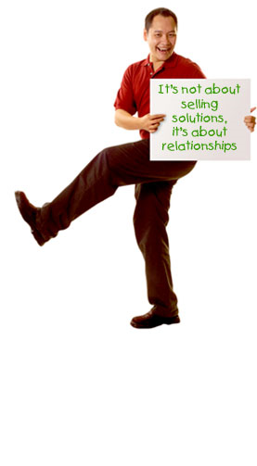
What is the goal of CRM?
To gain insight into the behavior of customers and the value of those customers.
An effective CRM strategy will increase revenues by:
providing services and products that are exactly what customers want
Provide better customer service
cross sell products more effectively
help sales staff close deals faster
retain existing customers and discover new ones
Notes:
CRM goal is better service, more effective sales, retention of customers, discovery of new customers.

Slide 22
Enterprise Resource Planning
System
Profit
Firm Infrastructure
Technology and Product Development
Inbound
Logistics
Operations
Outbound
Logistics
Marketing
& Sales
Service
Procurement
Human Resources

Slide 23
Enterprise Resource Planning defined
A business management system that integrates all facets of the business.
This includes:
planning
manufacturing
sales
marketing.

Slide 24
There are five major reasons why companies undertake ERP.
Integrate financial information
Integrate customer order information
Standardize and speed up manufacturing processes
Reduce inventory
Standardize HR information
Depaul has an ERP system. What is it called?
Notes:
ERP systems are the hardest to build.

Slide 25
Other important systems
Decision Support System
A computer application that analyzes business data and presents it so that users can make business decisions more easily.

Slide 26
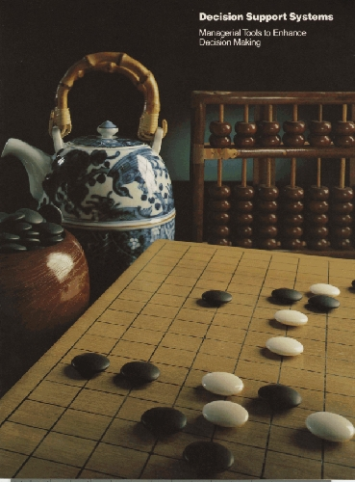
Type of DSS
Expert Systems
Decision Analytic Systems
Executive Information Systems
Group Support Systems

Slide 27
Other important systems
Unified Communications System
Integrates real-time communication services with non-real-times services. Provides a single point of contact for communicators and a single data repository for communication artifacts.

Slide 28
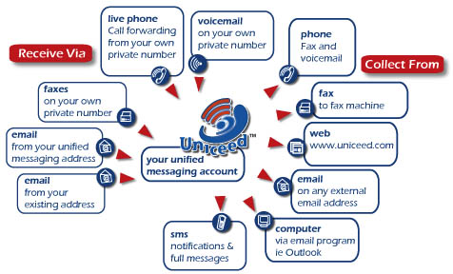
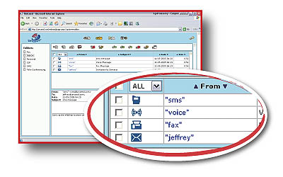
Cisco, Microsoft, and others have UC products

Slide 29
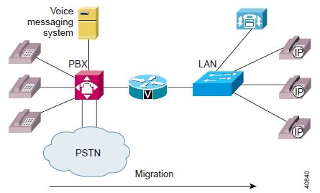
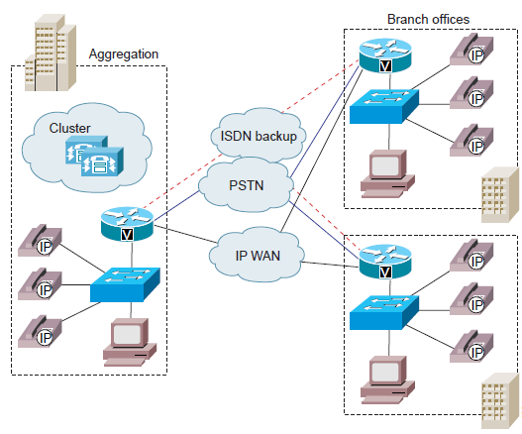
IPT (IP Telephony) or VoIP (Voice over IP)?
VoIP is a component of IP Telephony.
IP telephony solutions look to provide the exact same services as a public switch telephone network (PSTN) or internal business telephone network, using internet technologies instead of traditional analog lines.
*IPT = IP Telephony
©Cisco 2001

Slide 30

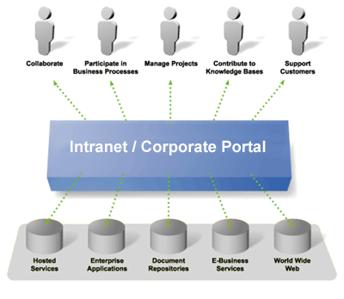
Other important systems
Portals and Intranets
.
An intranet portal is a central location for information and applications within an organization, presented in an electronic format

Slide 31
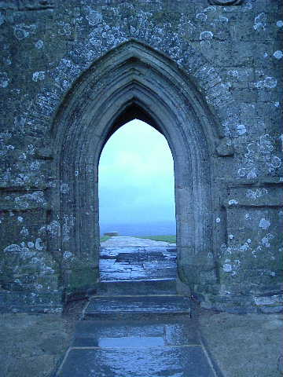
Intranets and Portals
Both Campus Connection and MyCDM are examples of Intranet Portals
Actually, CampusConnection is an ERP system with a Portal front end
Actually, MyCDM is a CRM system that also serves as a portal to other information

Slide 32

Lots of kinds of systems in the modern enterprise
Many of them are migrating to the cloud

Slide 33
Further, there are significant complementary architectural changes occurring as well
MVC Architecture
Middleware Platforms
Open Source
*I’m talking about this here so you will have some background on what we are doing with WordPress

Slide 34
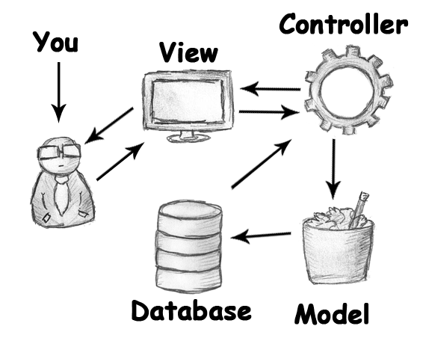
Model View Controller What it is, and why it is important
Software architectural design pattern for developing web applications
Separates
Database
Skin Design
Programming

Slide 35
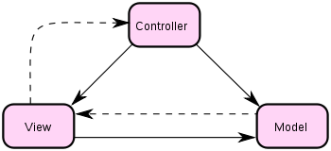
Model View Controller What it is, and why it is important
The Model – or a connector that stores information of each single table of a database. The model also does the validation of the data before it gets into the database. Most of the time you will find a table in the database and an relating model in your application.
Model stores the FRAMEWORK of the database. It’s a model after all!

Slide 36

Model View Controller What it is, and why it is important
The view – a website we actually see as viewers. Inside the view you will find (most of the time) HTML with embedded Ruby code. It performs tasks related solely to the presentation of the data.

Slide 37
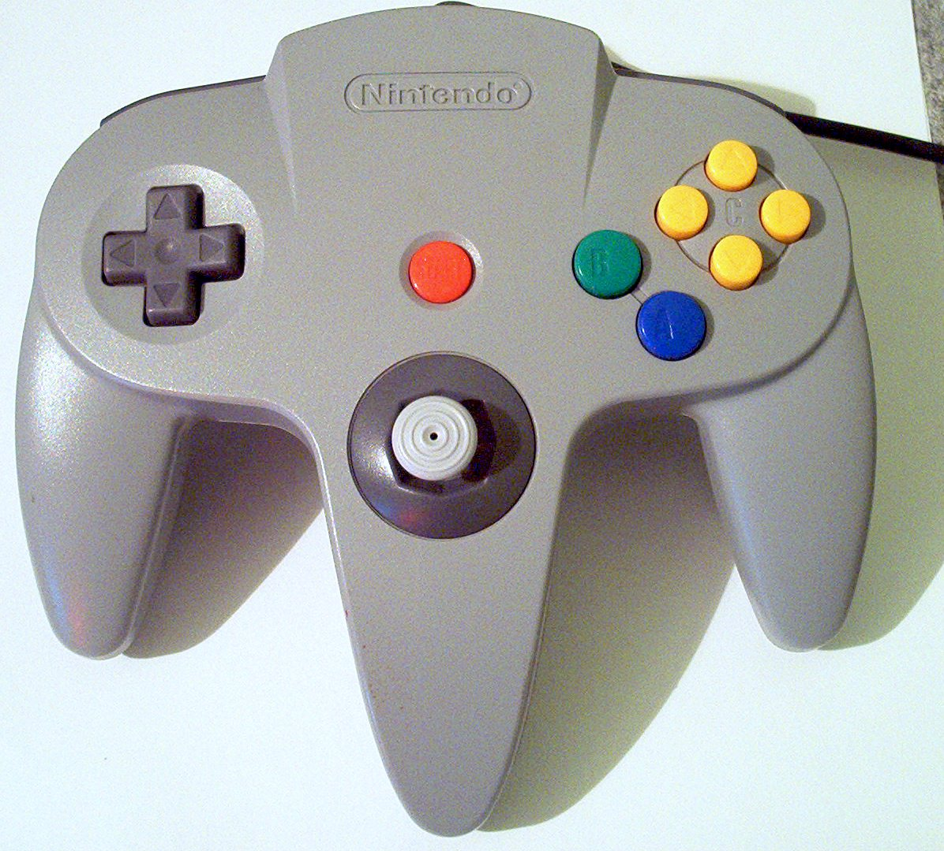
Model View Controller What it is, and why it is important
The controller – small bits of code that gets information from the database and displays it to the view.
The controller knows how to process the data that comes from the model and how to pass it onto the view.

Slide 38
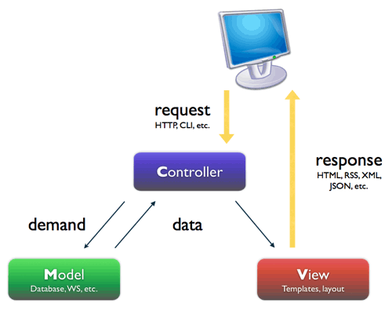
Model View Controller
Model
database tables (persistent data)
session information (current system state data)
rules governing transactions
View
(X)HTML
CSS style sheets
server-side templates
Controller
client-side scripting
http request processing
business logic/preprocessing

Slide 39






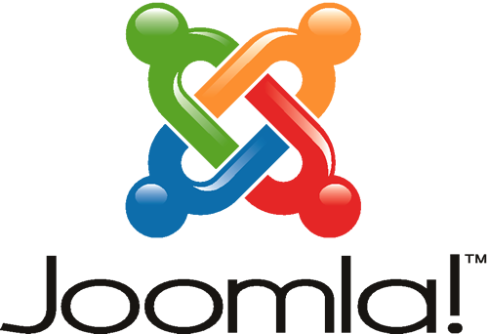
It’s about Content Management Systems Systems that decouple architecture, data, and presentation so that each can be managed separately.
Architecture: a software framework for fast modular construction of a system
Data: information stored and organized independent of architecture; ability to change content without touching software
Presentation: an skin independent of architecture and data; ability to change skins

Slide 40
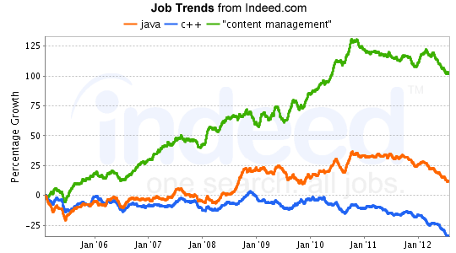
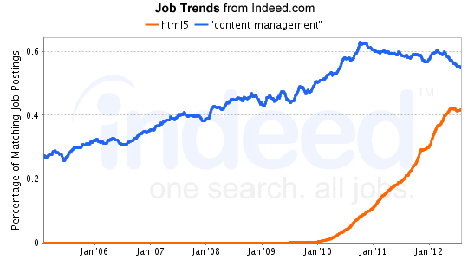
http://www.indeed.com/jobtrends?q=java,c%2B%2B,"content+management"&relative=1&relative=1

Slide 41
What does a CMS framework have?
Modularity
Security Model
Template/Skin/Theme also Language
User/Role Model
Media Management
Taxonomy
Workflow Model
Content Distribution Management
Front End / Back End Dashboard
Notes:
Domains of a CMS
Within an enterprise:
Used as a portal or Intranet
Used to support e-commerce functionality
Used to support workflow and document management
On the Internet
Used to present dynamic information
Used to build community

Slide 42
Uses of a CMS
Blogs (and discussion forums)
News and magazine style publishing
Online books
Social Networks
Knowledge repository
Portal
Enterprise Document Management
Enterprise Workflow Management
E-Commerce site

Slide 43
And this is one reason Why. . .
We are building a form of CMS using WordPress (Because it is easy and a good example of an MVC framework)
The message exchange environment we are using is a blog
We could have chosen a Wiki or a discussion board (used to call them bulletin boards or threaded discussions)
But we didn’t!!

Slide 44
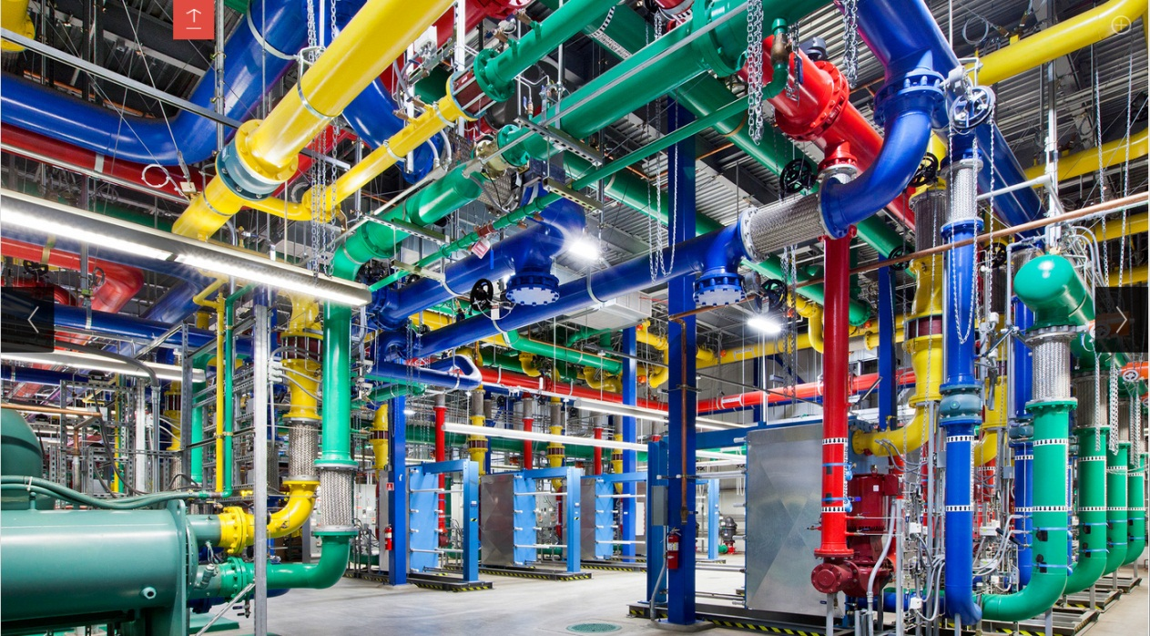
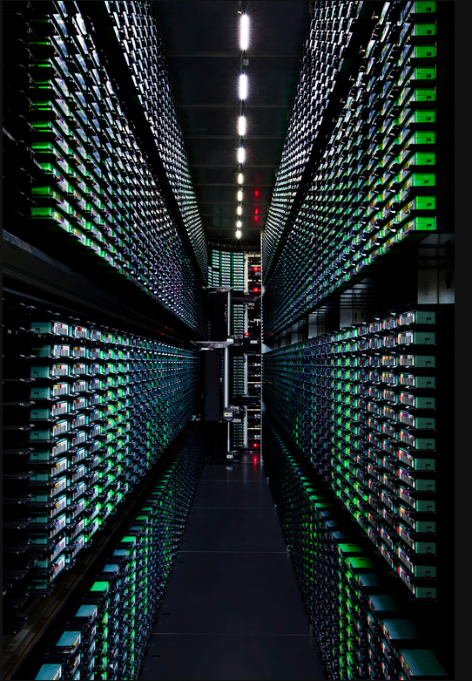
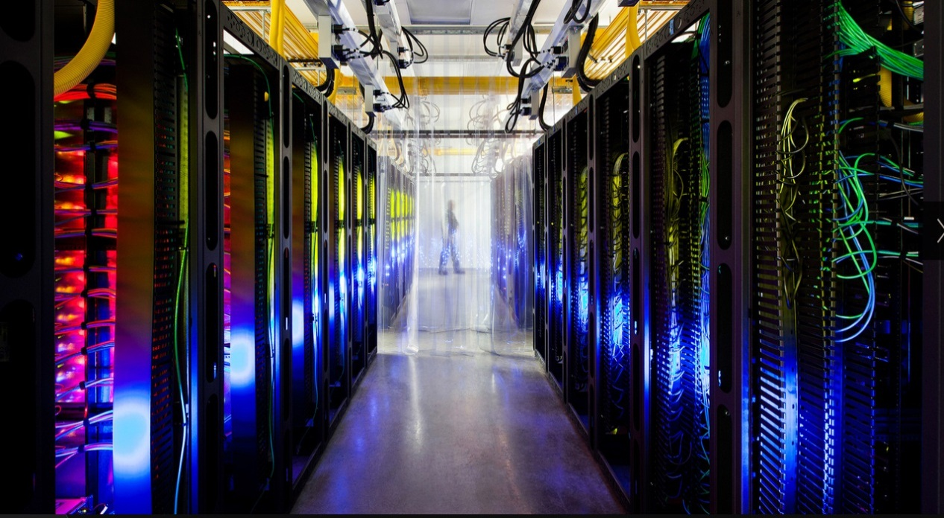
Cooling Pipes
Tape Library
Switching Center
Data Centers
http://www.google.com/about/datacenters/gallery/#/tech

Slide 45
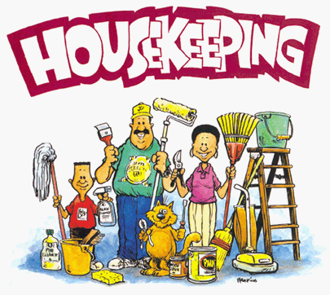

Slide 46
Memo 3 – What I want
I want you to find 3 white papers, read them, create a summary of the papers, criticize them for their strengths and weaknesses.
Find two repositories for articles about data center management (DCM)
(a repository will be a website that aggregates articles, often from various vendors, about the topic at hand. The site may also offer other related topics)
Give me the urls for at least 2 repositories, along with a summary of the types of information that can be found on the site.
Give me an annotated list by providing the white paper title, a url to the paper, authors and publication date (if known). Then give me your summary. I want 3 of these.

Slide 47
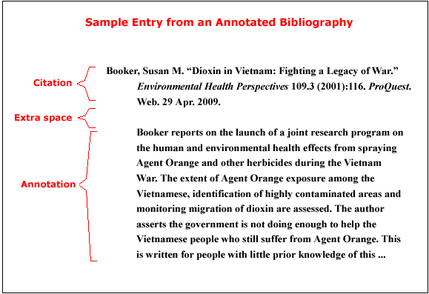
Annotated List -example

Slide 48
Memo Structure – Memo 3
Standard memo header
Standard memo body
Statement issue
Recommendation
This will be your annotated list
Background/Justification
This will be the list of repositories
There is NO required references section, since that information will be included in the annotated list.

Slide 49
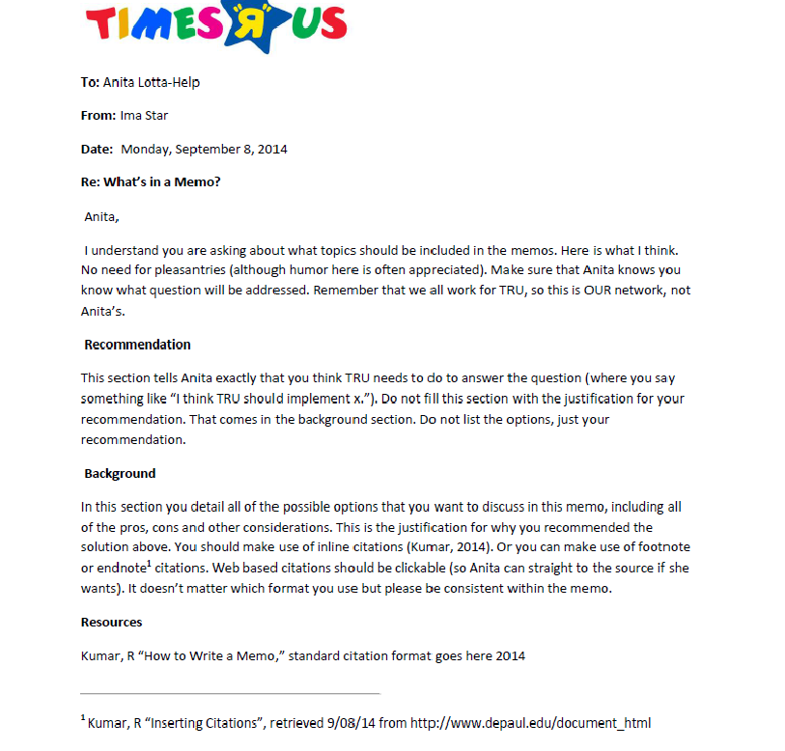

Slide 50
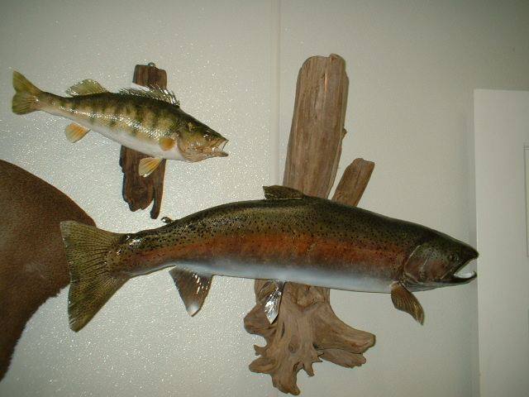
Web Assign 3
Taxonomy
Not Taxidermy!

Slide 51
Taxonomy
What is it?
“It is the practice and science of classification” (wikipedia)
In business it is a way of organizing data and information for later retrieval

Slide 52
Types of Taxonomies
Controlled Vocabularies
Knowledge Organization Systems
And many more

Slide 53
Controlled Vocabularies
A limited listing of terms
Term Lists (drop down boxes)
Synonym Rings
Authority file (subordinates pointing to preferred term)
Hierarchical Taxonomy

Slide 54
Definitions: Specific Types
Term List
A simple list of terms (a pick list)
Usually alphabetical, but could be other logical order
Lacking synonyms, it is usually short for quick browse
Can appear in drop-down, scroll boxes
May be used for various metadata values (document types, format types, job functions, source, department, etc.)
Example term list :
milk, bread, fruit, cheese, potato chips, butter

Slide 55
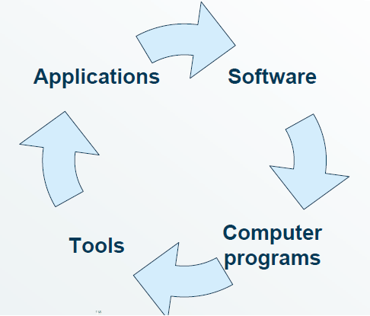
Definitions: Specific Types
Synonym Rings
A controlled vocabulary with synonyms or near synonyms for each concept
No designated “preferred” term: all terms point to each other, as a ring
Usually just called a “controlled” vocabulary
Example of a synonym ring taxonomy

Slide 56
Definitions: Specific Types
(Hierarchical) Taxonomy
A controlled vocabulary with broader term/narrower term relationships that include all terms to create a hierarchical structure
An emphasis on categories and classification
May or may not have associative term relationships or non-preferred terms

Slide 57
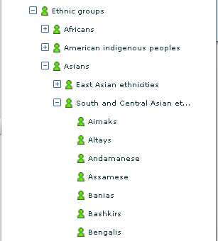
Definitions: Specific Types
Taxonomy example 1 (hierarchical):

Slide 58
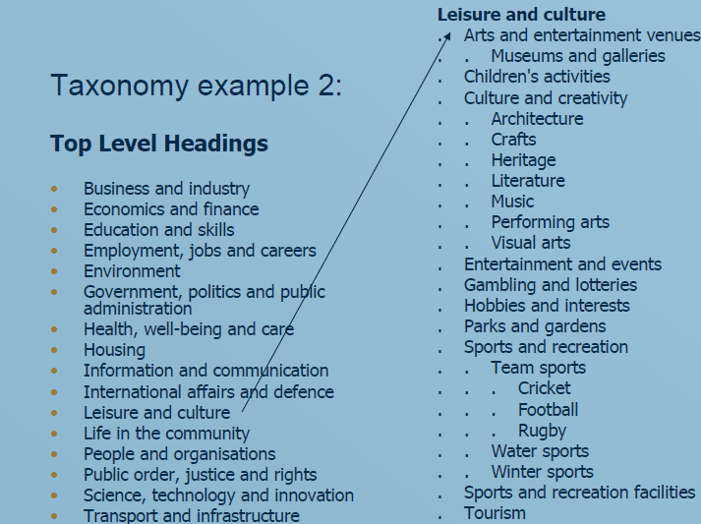
Definitions: Specific Types
Taxonomy example 2:
:

Slide 59
Topic and Type – Common Taxonomy structures
Topics: issues, specific headings
Aliens, Life_Insurance, Sport
Type: collections of topics, major categories of material type
News, Policy, Soccer

Slide 60
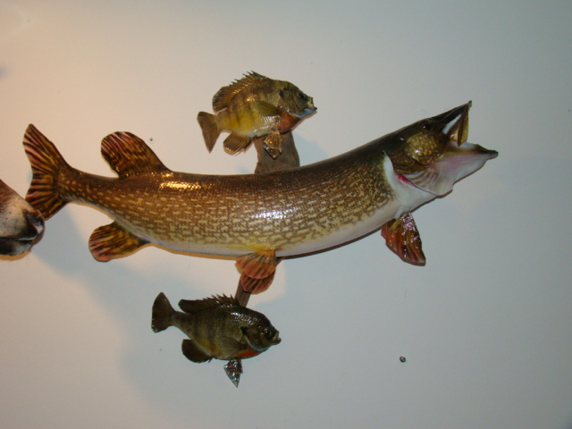
Why do you need one? (a taxonomy, not a stuffed fish)
Taxonomies Drive Information Organization
Taxonomies Drive the User Experience such as site navigation
Different people navigate according to their needs
Supports relating material
You may be able to offer the ability to follow by topic or type so people can subscribe to material that interests them
A key part of the process that needs to be taken into consideration when developing and implementing site taxonomy is the keyword research piece of search engine optimization (SEO)

Slide 61
Website Assignment 3
Prepare your Controlled Vocabulary List of:
Categories
Major topics for material that can be found on the site
Develop a list (controlled vocabulary) of anticipated topics for your site (minimum 5)
These MUST conform to your context
Develop a list of subcategories for ONE of your major categories (minimum 3 subcategories)
Every post MUST be assigned at least ONE category
Initial list of Tags (these do not need to be implemented for Web 3)
(these tend not to be controlled) include in your doc to D2L (minimum 5 tags)
These are the specific tidbits in your material
Every post MUST be assigned at least ONE tag (and more if you implement a Tag Cloud widget)
On your site you must implement 1 and 2
NOTE: Your categories will not appear on the frontend until there is an article using the category – one reason we grade from the backend!!

Slide 62
WordPress Tutorial Website Assignment 4
In WordPress, a "taxonomy" is a grouping mechanism for some posts or links or custom post types. WordPress has four built in default taxonomies:
‘Category ‘: taxonomy lets you group posts together by sorting them into various categories. Categories tend to be pre-defined and broad ranging.
‘Tag’: taxonomy is similar to categories, but more free form. Tags can be made up on the fly, by simply typing them in.
‘Link_category‘: taxonomy lets you categorize your links. These tend to be used only internally, for organizational reasons, and are not usually exposed on the site itself. They are handy for defining groups of links to be displayed in sidebars and the like.
‘Post Formats’: taxonomy was introduced in Wordpress 3.1 and is a piece of meta information that can be used by a theme to customize its presentation of a post. New post formats can't be created or added to the default existing ones

Slide 63
WordPress Tutorial Website Assignment 4
You should have your context and your site and tonight we talked about your taxonomy
Think about your site – what do you want it to look like, what features do you want? Do this BEFORE you choose a Theme!!
Choose and install a Theme
Be sure to get one you can customize! (be sure it has at least One customizable Menu)
At least two columns (one for your articles, one for navigation)
Plugins
Code that changes/improves/adds functionality to your site
May or May Not come with a corresponding Widget
Widgets
Code that changes the User experience (frontend functionality)
Will not display until you add the widget to your theme

Slide 64
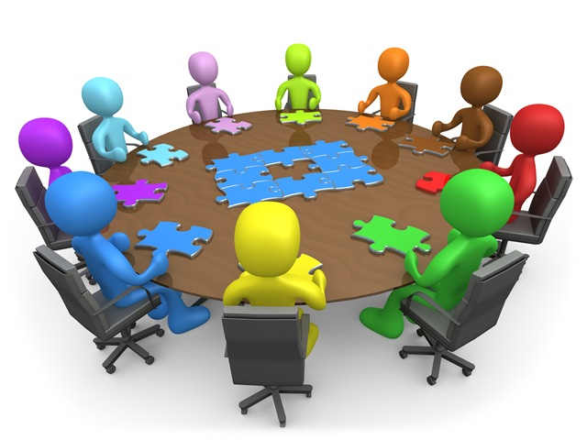
Memo 2 Discussion – WAN Technologies
What we should be doing to connect all of the regional offices/distribution centers and their stores to Hoffman Estates?
What are the issues?
What are the options?
Are there any constraints?
What are your recommendations?

Slide 65
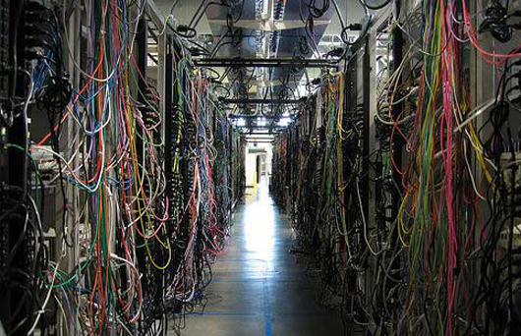
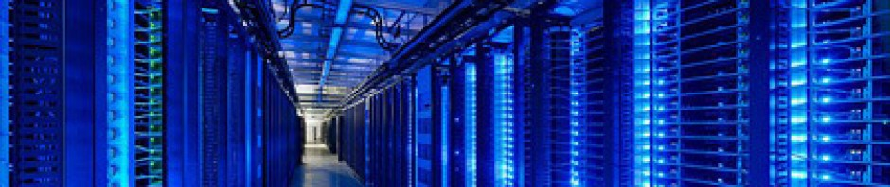
Data Centers
ECT 424
IS 324
Class 4

Slide 66
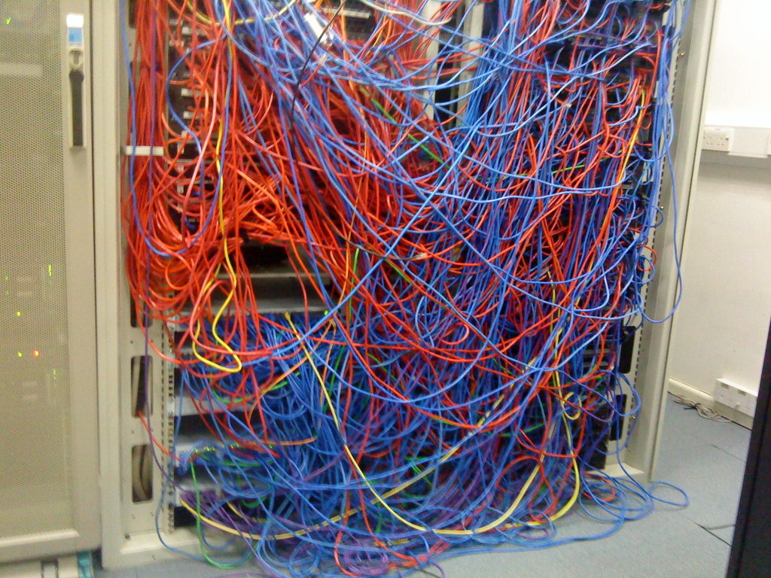
Datacenters
What does a data center do?
What are the components of a datacenter?
What are some of the characteristics of a datacenter?
Example of a datacenter
Issues encountered when operating a datacenter
Current trends and potential solutions to the datacenter issues

Slide 67
What does a Data Center do?
Video placeholder
What is a data center

Slide 68
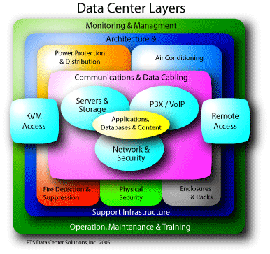
Logical DC Management Structure

Slide 69
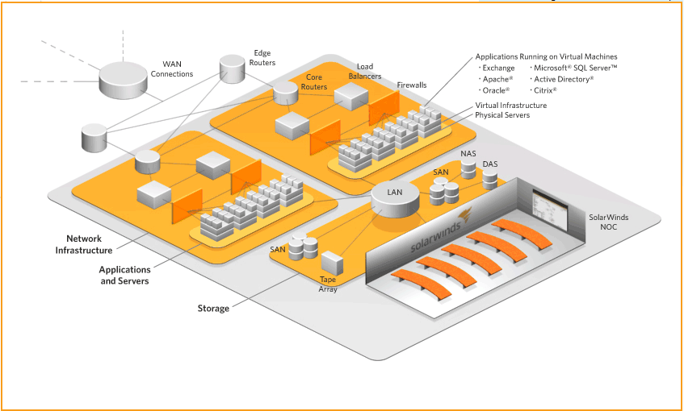
Logical Data Center Layout

Slide 70
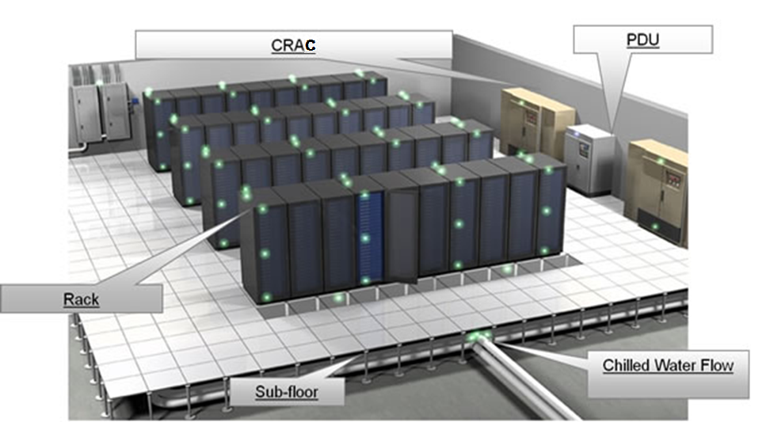
Physical Layout – Raised Floor
CRAC
Notes:
PDU is a Power Distribution Unit is a device fitted with multiple outputs designed to distribute electric power, especially to racks of computers and networking equipment located within the data center.
A computer room air conditioning (CRAC) unit is a device that monitors and maintains the temperature, air distribution and humidity in a network room or data center. CRAC units are replacing air-conditioning units that were used in the past to cool data centers.

Slide 71
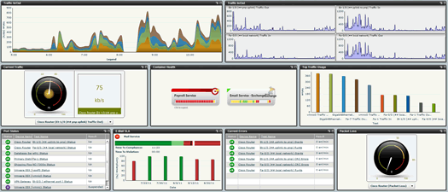
Data Center Monitoring
Part of data center monitoring includes UPS Uninterruptable Power Supply, PDU (Power Distribution Unit), cooling system, security and environmental monitoring devices, and most of which go for Modbus RTU control, an automation control protocol.
But with the popularity of Ethernet, the management of control center goes for SNMP, a network management protocol. SNMP is generally used by IT management, and the advantage to adapt SNMP in automation is the real/write privilege and easy management.

Slide 72
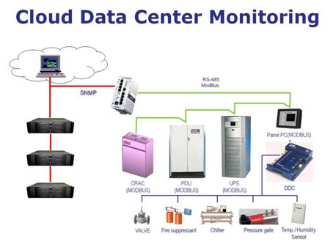
Need a device/software to work as a gateway between Modbus RTU and SNMP and brings customers benefit from an integrated solution composed of data center monitoring and IT management tools. This combination provides single view of each customer’s data center monitoring and IT management.
Notes:
There is a Modbus program inside to map the Modbus ID and data to SNMP OID. The program identifies the data and alarm points that can be read from the device by a master through SNMP and connects each point to the Modbus address needed to access it. Users can read and write the Modbus message through the mapping mechanism for different applications.

Slide 73
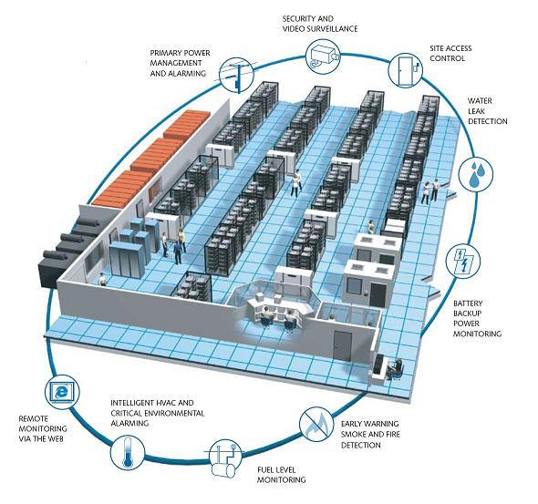
Data Center Monitoring
Data center monitoring has evolved from a simple alert system, a “nice-to-have” feature, into a critical element required for maximizing uptime and ensuring the increasingly complex environment within the data center is running effectively and efficiently.

Slide 74
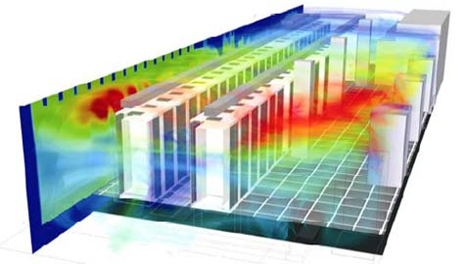
Data Center Monitoring
Modbus is a serial communications protocol (made by Schneider Electric in 1979) for use with its programmable logic controllers (PLCs).
It has since become the standard communication protocol, and it is now a commonly available means of connecting industrial electronic devices.
The main reasons for the use of Modbus in the industrial environment are:
developed with industrial applications in mind
openly published and royalty-free
easy to deploy and maintain
Modbus enables communication among many (approximately 240) devices connected to the same network.
Simple Network Management Protocol (SNMP) is an internet-standard protocol for managing devices on IP networks. Devices that typically support SNMP include routers, switches, servers, workstations, printers, modem racks and more. SNMP is used mostly in network management systems to monitor network-attached devices for conditions that warrant administrative attention.
Notes:
PROFIBUS (Process Field Bus) is a standard for fieldbus communication in automation technology and was first promoted in 1989 used by Siemens. It should PROFIBUS is neither an openly published nor a royalty-free protocol, as opposed to MODBUS.
Stuxnet is a computer worm that was discovered in June 2010. It was designed to attack industrial Programmable Logic Controllers or PLCs.
Stuxnet installs malware into memory block of the PLC that monitors the Profibus messaging bus of the system.
For more information about Stuxnet, watch the PBS Nova series “Rise of the Hackers”

Slide 75
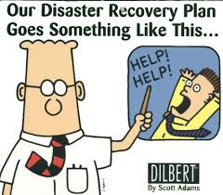
Importance of Redundancy and Disaster Recovery
So why are disaster recovery plans critical elements for every business?
Disaster recovery and business continuity planning are processes that help organizations prepare for disruptive events—whether those event might include a hurricane or simply a power outage caused by a backhoe in the parking lot.
Gartner Group studies reveal that close to 40% of the businesses that undergo catastrophic data loss or data center downtime never recover from it.
Also, 2 out of every 5 businesses completely fail when faced with such catastrophes.
So essentially 40% of the group of Data Centers that failed cause the company to go belly up!

Slide 76
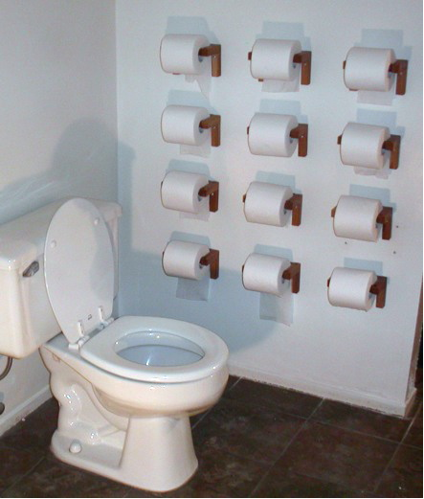
What does Redundancy mean?

Slide 77
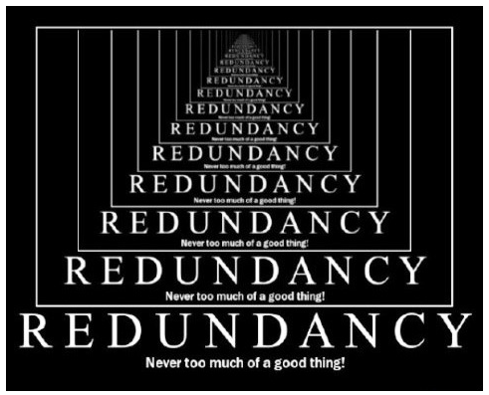
Importance of Redundancy and Disaster Recovery
And why is redundancy chosen as a better recovery plan over other DR plans?
With redundant systems, the business critical programs and data are backed up securely on a data center . This ensures that primary data center disasters do not affect the data and the information can be completely restored, faster than from any other DR options.

Slide 78
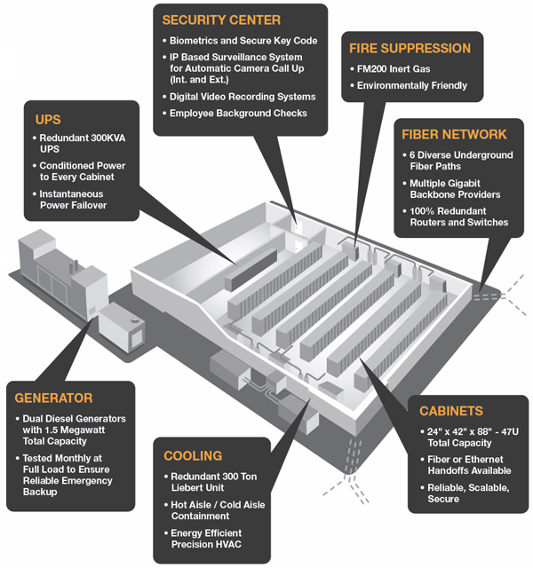
Redundancy and Disaster Recovery

Slide 79
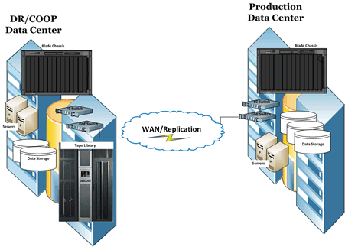
Whole Site Redundancy
Disaster Recovery (DR) and Continuous Operations (COOP)
Even in the case of disasters, secondary backup systems allow seamless transitions from the primary systems.
This guarantees less data center downtime and increases employees’ productivity by eliminating duplicate efforts towards recovering lost data.

Slide 80
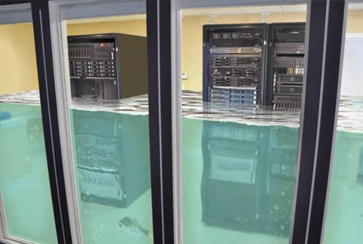
Importance of Redundancy and Disaster Recovery
So why don’t all businesses employ redundant data center systems ?
extra space requirements
the cost involved
maintenance of secondary IT systems
But.. what’s more costly?
The loss of your business or the protection of all of your data?

Slide 81

Managing Risk
Higher costs!
Notes:
In Managing Risk the quicker the recovery time the higher the cost.
Dual sites and global failover will COST an organization

Slide 82

Risk Mitigation
Risk mitigation is simply taking steps to reduce adverse effects.
There are four types of risk mitigation strategies that hold unique to Business Continuity and Disaster Recovery.
Risk Acceptance: Risk acceptance does not reduce any effects however it is still considered a strategy.
Risk Avoidance: Risk avoidance is the opposite of risk acceptance. It is the action that avoids any exposure to the risk whatsoever. Risk avoidance is usually the most expensive of all risk mitigation options.
Risk Limitation: Risk limitation is the most common risk management strategy used by businesses. This strategy limits a company’s exposure by taking some action.
Risk Transference: Risk transference is the involvement of handing risk off to a willing third party. For example, numerous companies outsource certain operations such as customer service, payroll services, etc. This can be beneficial for a company if a transferred risk is not a core competency of that company. It can also be used so a company can focus more on their core competencies.
Notes:
Risk Acceptance: I build a data center in California where it is prone to earthquakes
Risk Avoidance: I avoid California because of earthquakes and never build my data center there or move it from CA.
Risk Limitation: I build my data center in California, but below my data center I build infrastructure that can withstand an earthquake
Risk Transference: I outsource my data center risk to cloud service provider to handle because I am not an IT shop. I am a retailer

Slide 83



Risk Mitigation
Risk Limitation example

Slide 84

Power Source
Redundancy
Multiple power sources and generators provide for risk mitigation by limiting the risk

Slide 85


Fire Suppression
Fire suppression systems limit the risk of a fire at the data center

Slide 86


Cooling Options
Cooling systems offer protection for the data and the computing hardware

Slide 87


Managing Temperature
Temperature sensing systems
offer data center monitoring alerts in case of overeating or malfunctioning equipment

Slide 88


Power Usage Effectiveness (PUE)
PUE is a measure of how efficiently a computer data center uses energy; specifically, how much energy is used by the computing equipment (in contrast to cooling and other systems).
PUE | Level of Efficiency
3.0 | Very Inefficient
2.5 | Inefficient
2.0 | Average
1.5 | Efficient
1.2 | Very Efficient
PUE calculator: http://www.42u.com/measurement/pue-dcie.htm

Slide 89
Data Center Tier Classification
The Tier classifications were created to consistently describe the site-level infrastructure required to sustain data center operations, not the characteristics of individual systems or sub-systems.
The requirements were established by the Uptime Institute, Inc. (a think tank and professional-services organization based in New Mexico) and are necessarily and intentionally very broad to allow innovation in achieving the desired level of site infrastructure performance, or uptime.
The individual Tiers represent categories of site infrastructure topology that address increasingly sophisticated operating concepts, leading to increased site infrastructure availability.

Slide 90
Data Centers Tiers
Tier I: Basic Site Infrastructure
Non-Redundant Capacity Components and Distribution paths.
Any Capacity Component or Distribution Path failure will impact the computer systems.
Planned work will require most or all of the systems to be shutdown.
Tier II: Redundant Capacity Components Site Infrastructure
Redundant Capacity Components, but single Non-Redundant Distribution Paths serving the site’s computer equipment.
Redundant UPS modules and engine generators are required.
A distribution path failure will cause the computer equipment to shut down.

Slide 91
Data Centers Tiers (cont)
Tier III: Concurrently Maintainable Site Infrastructure
Redundant capacity components and multiple distribution paths serving the site’s computer equipment. Generally, only one distribution path serves the computer equipment at any time.
Each and every capacity component and element of the distribution paths can be removed from service on a planned basis without causing any of the computer equipment to be shut down.
Tier IV: Fault Tolerant Site Infrastructure
Redundant capacity systems and multiple distribution paths simultaneously serving the site’s computer equipment
The site is not susceptible to disruption of service from a single unplanned worse-case event.
Infrastructure maintenance may be performed by using redundant capacity components and distribution paths to safely work on the remaining equipment.

Slide 92


Slide 93
Virtual tour of a Data Center
Video placeholder
Virtual data center Tour

Slide 94
Trends & Issues - Increasing Density
Density of computing equipment has been increasing (i.e., smaller circuits, multiple cores, blade servers, etc.)
Old server: 3-4 U, 100 W [each U=1.75” or 44.5mm]
New server: 1 U, 250-500 W
Decade ago 500-1000 W per rack was typical
Currently, 42 U rack can easily draw 10-20 kW

Slide 95
Trends & Issues - Increasing Heat
A Rack drawing 10-20 kW can generate 30,000-70,000 British Thermal Units (BTUs) of heat
1 BTU is the energy required to heat 1 pound of water 1 degree
A chiller pumps coolant to multiple computer room air conditioners (CRACs)
Frequently, the capacity of a cooling device is measured in terms of tons. 1 ton of cooling can dissipate ~12,000 BTUs of heat

Slide 96
Trends & Issues - Requirements
Every kW used by a server requires another kW for cooling, airflow, lighting
Cooling requirements are approximately 3-6 tons per rack
Source: Intel Corporation, 2010

Slide 97

Trends & Issues - Major Cost
Power and cooling requirement can be #1 and #2 cost for operating a data center
"In some cases, power costs account for 40-50% of the total data center operation budget" (Intel, 2010)

Slide 98

Datacenter Design - Classic
ANSI\TIA-942 describes classic design
Specification describes basic hot aisle\cold aisle configuration
Server fronts face each other, while backends vent to create a common hot aisle
CRAC units intake hot air (along top of perimeter) and returns cool air (bottom of raised floor)
Raised floor acts as plenum containing cold air which is forced up through floor openings

Slide 99


Datacenter Design - Classic
How cold should we keep the data center?
60º F
72º F
80º F
60º F
68º F
77º F
86º F
95º F
Thermal Top View - Hot & Cold Aisles
Warm
Cold

Slide 100

Traditional Raised Floor

Slide 101
Datacenter Design - Classic Issues
Classic datacenter design highly effective when properly implemented
Biggest challenge is proper path allowing cold air to reach all devices (without prematurely mixing)
Cold air may not reach devices at the very top of the racks
The raised floor must be sufficiently high to accommodate cabling while providing sufficient plenum and avoid disrupting airflow
Even proper classic design may provide insufficient cooling for some high-density devices

Slide 102
Datacenter Design - Alternate Approach
Some debate exists around cooling systems without raised floors
Overhead cable trays and duct work are used in some facilities (especially smaller data centers), but management of air flow is extremely difficult in such a system
Depends significantly on fans to direct cool air down
If classic design cannot remove sufficient heat, an overhead installation is unlikely to provide better results, and a local rack cooling solution may be necessary for the specific hot spot.

Slide 103

In-line cooling

Slide 104

Another Alternative Approach

Slide 105


Slide 106
Cooling Issues
Ensure optimal airflow & velocity
Adequate airflow
Additional blowers
Adequate CRAC (computer room air conditioning) capacities
Appropriately spaced
Add blocking panels
Remove any obstacles (e.g., cable management)
Space configuration of CRACs\racks
Well-sealed floor panels & unwanted openings
Correct orientation of racks
Sufficiently large cold air return path (i.e., plenum)

Slide 107
Data Center Cooling Issues
Video placeholder
Cooling a data center

Slide 108

Containerized Data Centers
http://www.youtube.com/watch?v=M-3bdWCOSMQ

Slide 109
Virtualization: The Foundation for a Greener Datacenter
Today: 70 million virtual desktops

Slide 110


Market Perspective
kW per Rack
Datacenters becoming exponentially more dense
Datacenter refresh driven by power/cooling/space
Energy cost is consuming more budget and is harder to ignore
The divide between IT and facilities is narrowing
Environmental impact, govt awareness and corporate initiatives on the rise
Cost to Power Server Will Soon Exceed Purchase Price
Notes:
In terms of what's happening in the market, the first thing is that datacenters are becoming a lot more dense. The kilowatts per rack has gone up quite dramatically in recent years and the trend is continuing. As you move to blade servers, you have more dense form factors that consume more power. One customer, an executive, went down to the datacenter because he heard from his IT department that it was full. But, it turns out, the datacenter is only half physically full (from a facility and space standpoint), but has no more electrical power.
This risk of customers running out of power in the datacenter is real. In fact, Gartner said that 50% of companies would face this situation by this year. Many companies are making a datacenter refresh decision based solely on power/ cooling and space considerations.
In terms of energy, the first thing you hear today from customers is about reducing costs. Traditionally, we've been able to ignore costs on energy for some time because Facilities was paying the bill (IT wasn't accountable for the energy bill). But in the next couple of years, this is going to change. There's going to be accountability, and as a result, there will be a more holistic view of the costs of deploying a new application. This will include calculating in the facilities cost, which can be four or five times the cost of the IT infrastructure.
Recently, there's a lot more awareness of what's happening in the datacenter from an environmental perspective. Governments are starting to get involved in the regulation of carbon emissions and so there's a big risk that companies, if they don't do this proactively, will be forced to do it.
Perhaps more interestingly, there's an opportunity to leverage a Green Datacenter for differentiation purposes. Companies that proactively do this not only reap financial advantages, but also corporate goodwill, as responsible and progressive companies that will attract the best talent available.

Slide 111

“We need more power captain!”

Slide 112

Cost Savings Potential
“Power consumption per server in a data center was recently reported to have passed the cost of the server itself during its lifetime – typically three years. Data centers consume 1.2 percent of global power – 2 percent in the U.S. – and there are only approximately 13,000 of them. The number of data centers being built around the world is expected to double by 2016.”
http://www.triplepundit.com/2013/02/sustainable-data-center-future/

Slide 113



Consolidating Server, Storage, Network & Facilities
VMware consolidates servers, storage and networking infrastructure to safely achieve higher utilization
BEFORE VMware
AFTER VMware
Servers
Storage
Network
Facilities
1,000
Direct attach
3000 cables/ports
200 racks
400 power whips
Planning expansion
80
Tiered SAN and NAS
300 cables/ports
10 racks
20 power whip
Defer/avoid $1k per sqft expansion cost
Source: Actual customer data
http://www.slideshare.net/datacenters/vm-ware
Notes:
113
Let’s look at a real life customer example:
In 2003, the IT service arm of a leading North American energy company started a consolidation project, using VMware Infrastructure as the primary vehicle for achieving this.
The customer had 1000+ x86 industry standard servers,
- >100 SQL servers
- Lotus notes mail servers
- Citrix servers
- Lots of Line of Business applications
Using VMware as the primary system infrastructure strategy capability, they ended with 80, 8-socket capable IBM x440 servers, a 12 to 1 reduction.
What is interesting is how consolidation has affected their infrastructure beyond the reduced server count.
Virtualization based consolidation not only affects the servers that are consolidated, but raises the quality and service levels of everything around it, including storage, network and facilities. Specifically in this project.
Consolidation of Storage: moved from silo’d direct attached storage to highly available Tiered Storage, specifically a Hitachi SAN
A 10:1 consolidation of network ports, or in the words of the customer “from spaghetti wiring to world class datacenter.”
Dramatic power savings and cost avoidance on the facilities and hardware infrastructure.
The main point is at the bottom: the real estate piece. In the U.S. the average cost of building out new space is $1,000 per square foot. So these can be hundreds of millions of dollars that you're spending in new space. The value of deferring or altogether avoiding that expense garners executive attention. It is a real and tangible savings.

Slide 114

Improved Cable Management

Slide 115









Right-Size IT Infrastructure
Consolidate…
…entire farms of servers and storage…
HW
HW
HW
HW
HW
HW
…and dynamically optimize to only consume the resources you need!
HW
HW
HW
HW
HW
HW
HW
HW
HW
HW
HW
HW
http://www.slideshare.net/datacenters/vm-ware
Notes:
Your IT server load is dynamic. It's always changing based on market or corporate situations, whether through acquisition or growth.
As a result, it's really about continuous right-sizing IT infrastructure, server, storage and networking. We're doing this across the datacenter and doing it in real time. We want to dynamically match the compute requirements to the energy supply. You only want to be using as much energy as you need to meet service levels that your business and your users require.

Slide 116

Let’s you move live, running virtual machines from one host to another while maintaining continuous service availability.
http://www.slideshare.net/datacenters/vm-ware

Slide 117
Storage approaches

Slide 118

Network Attached Storage
Server with lots of HD space
Uses existing network infrastructure

Slide 119


Storage Area Network
Windows
Linux
Unix
Fiber channel

Slide 120

SAN vs NAS
Notes:
NAS vs SAN
NAS provides both storage and a file system. This is often contrasted with SAN (Storage Area Network), which provides only block-based storage and leaves file system concerns on the "client" side. SAN protocols are SCSI, Fibre Channel, iSCSI, ATA over Ethernet (AoE), or HyperSCSI.
Despite their differences, SAN and NAS are not mutually exclusive, and may be combined as a SAN-NAS hybrid, offering both file-level protocols (NAS) and block-level protocols (SAN) from the same system. An example of this is Openfiler, a free software product running on Linux based systems.

Slide 121

Data Center Storage

Slide 122
Client VDI

Slide 123
Additional VDI Background
Persistent
Each user gets their own image
User settings saved, personalizable, more readily accepted
Requires substantially more storage and image management
Non-persistent (golden image)
One image per user group, fresh every time
No personalization
Requires much less storage and image management, more secure
Notes:
With one-to-one persistent VDI, each desktop runs from a separate disk image. The user's settings are saved and appear each time at login. These types of desktops allow for more personalization, but they require more storage and backup than nonpersistent desktops.
Advantages: Customization and familiarity
Cons: Storage requirements and image management
When users access a nonpersistent desktop, none of their settings or data is saved once they log out. At the end of a session, the desktop reverts back to its original state and the user receives a fresh image the next time he logs in.
Advantages: Image manageability, greater security, less storage
Cons: Less personalization, application flexibility

Slide 124
Client side
Thick client
Goes well with persistent images
User can work even if there is no network available
Less benefits, runs thin client software to create VDI
Thin client
Not much processing capability, goes well with non-persistent images
Requires access to network to get work done
Less expensive, centralized management
Zero client
Even less processing capability (essentially a monitor with keyboard, pointing device and a NIC)
Less expensive still, proprietary

Slide 125
VDI vs DaaS
Same types of benefits
Simplified desktop management, less hardware, increased flexibility, data control
DaaS requires not just network access but Internet access to work
PROS - doesn’t require the backend servers and virtualization (managed by the provider– servers, resource provisioning, load balancing)
Good possible solution if you have no virtualization experience
CONS - trust/security – lack of control, connectivity, reliability, who owns the data stored at the provider sites? (and where are those sites anyway?)
Notes:
DaaS -Desktop as a Service

Slide 126
Readings from This Week
Data Center Issues
What did you learn?
Did you agree with everything?
What other issues do you think are important?
Costs
Anything missed?

Slide 127
Readings for Next Module
Cloud Computing
What is needed for the Cloud
Optional (but highly recommended). Retail Use of the Cloud from ARTS (Association for Retail technology Standards

Slide 128
Google Data Center tour
Video placeholder
Google data center

